Slide 1
WIRELESS POWER TRANSFER FOR ELECTRIC VEHICLES
PHASE II
PROJECT WORK STAGE - II REVIEW
Presentation by, Guided by,
SANTHOSH R Dr . JEGADISH KUMAR K.J
SURYA PRAKASH B Associate Professor ECE Dept

Slide 2
OUTLINE
Objective
Motivation
Process workflow
Design for inductive coupling
MATLAB Design
Simulation Result
Hardware Design
Hardware section
Literature survey
Conclusion
Future work

Slide 3
OBJECTIVES
To Design a Wireless power transfer (WPT) technology using inductive power transfer concept for charging electric vehicles (EVs)
To Design an Inductive Coupling Circuit for Efficient Transfer of 48 voltage from the Primary to Secondary Coil.
To analysis the working of wireless power transfer for EVs

Slide 4
MOTIVATION
Wireless power transfer (WPT) projects for electric vehicles aim to enhance charging convenience and user experience by eliminating the need for physical cables.
This technology offers benefits such as reduced wear and tear on connectors, seamless integration into environments like parking lots, and the potential for dynamic charging while vehicles are in motion.

Slide 5
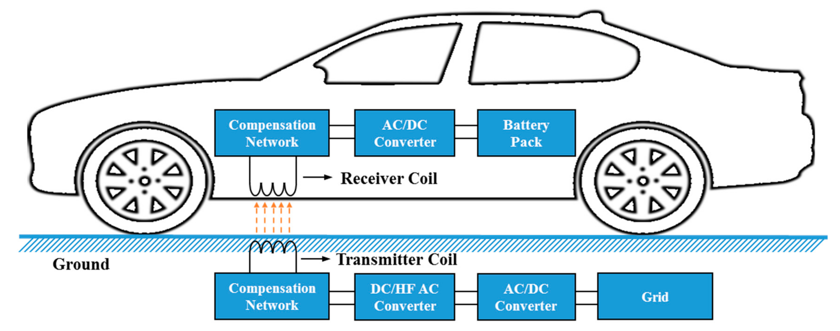
PROCESS WORKFLOW
Grid input: Supply from AC source of 230 volts with low frequency (approx.50 Hz).
Full bridge Rectifier: AC power is converted into DC power
MOSFET Inverter: The low frequency DC power is converted into High frequency AC power.
Mutual inductance: Then the High frequency AC current is passes through the primary coil which generates alternating flux. Now the alternating flux induces EMF in secondary coil due to electro magnetic induction. The coils are not connected by any core and separated by air space-Loosely coupled AC current induced in secondary coil is rectified and produced DC output which charges the battery.
Battery: output power stored to the battery

Slide 6
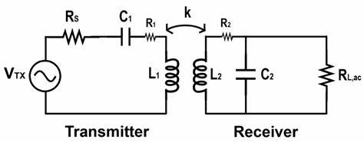
INDUCTIVE COUPLED CIRCUIT DESIGN
V_{tx}- Primary side voltage supply(high frequency AC voltage)
C₁&L₁-Primary side capacitor and inductor.
C₂&L₂-Seconday side capacitor and inductor.
R_{L}- Equivalent resistor of the battery as viewed from primary coil.
jωMI₂-Mutual induced emf in the primary winding due to current flowing in secondary coil.
jωMI₁-Mutual induced emf in the secondary winding due to current flowing in primary coil.

Slide 7
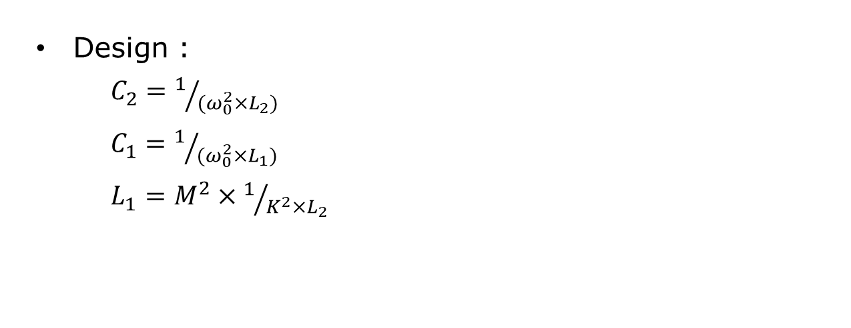
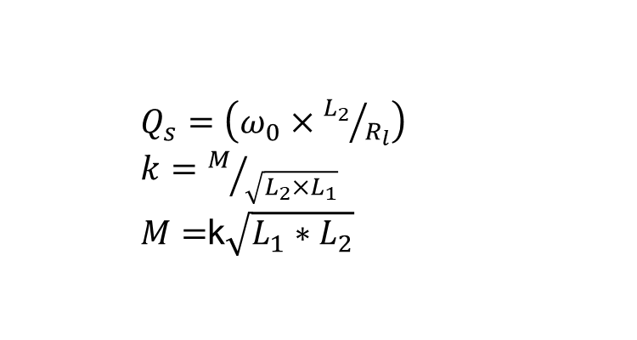

CIRCUIT DESIGN
$Q_{s}=\left(ω_{0}×{L_{2}}/{R_{l}}\right)$
$k=M/{\sqrt{L_{2}×L_{1}}}$
$M=$k$\sqrt{L_{1}∗L_{2}}$
Design :
$C_{2}=1/{(ω_{0}^{2}×L_{2})}$
$C_{1}=1/{(ω_{0}^{2}×L_{1})}$
$L_{1}=M^{2}×1/{K^{2}×L_{2}}$
$$L_{2}=Q_{s}×{R_{l}}/{ω_{o}}$$

Slide 8
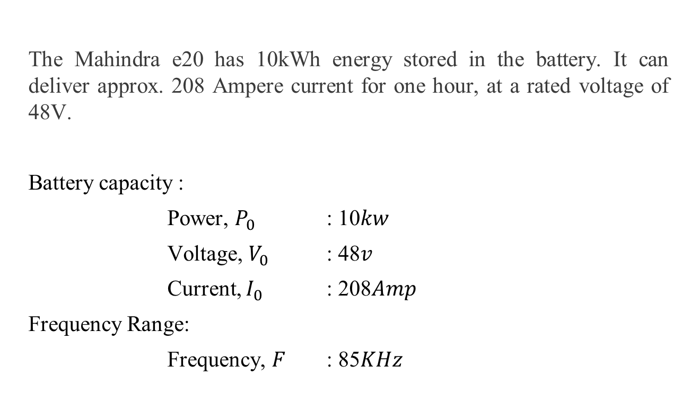
DESIGN For Inductive Coupling circuit
The Mahindra e20 has 10kWh energy stored in the battery. It can deliver approx. 208 Ampere current for one hour, at a rated voltage of 48V.
Battery capacity :
Power, $P_{0}$ : 10$kw$
Voltage, $V_{0}$ : 48$v$
Current, $I_{0}$ : 208$Amp$
Frequency Range:
Frequency, $F$ : 85$KHz$

Slide 9
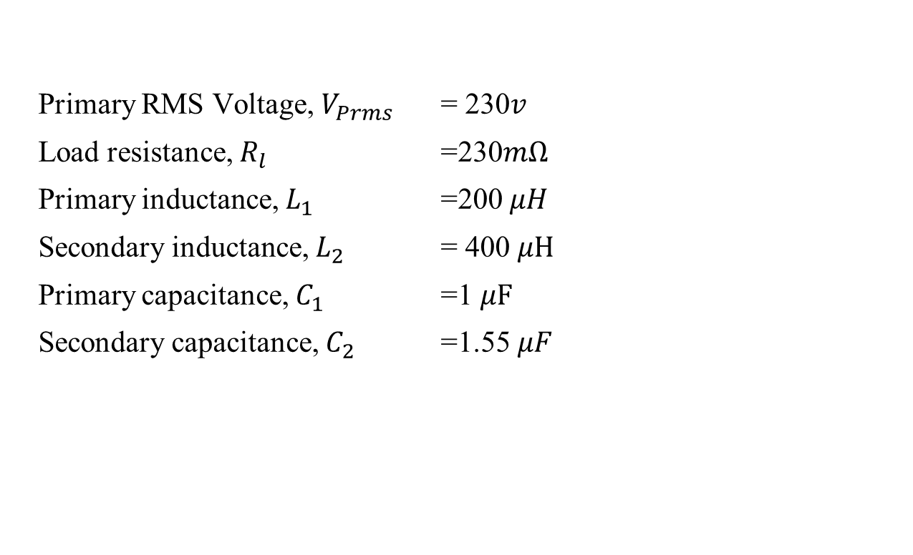
DESIGN For Inductive Coupling circuit
Primary RMS Voltage, $V_{Prms}$ = 230$v$
Load resistance, $R_{l}$ =230$mΩ$
Primary inductance, $L_{1}$ =200 $μH$
Secondary inductance, $L_{2}$ = 400 $μH$
Primary capacitance, $C_{1}$ =1 $μF$
Secondary capacitance, $C_{2}$ =1.55 $μF$

Slide 10
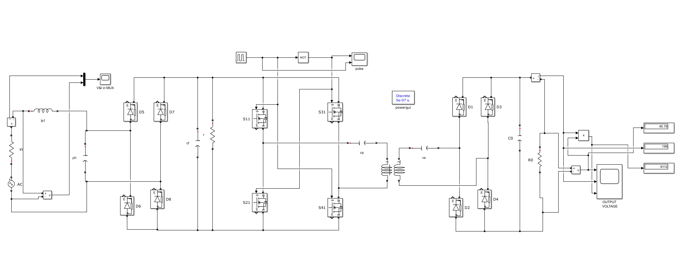
MATLAB
230V
AC Source
Full bridge Rectifier
(1N5408 Diode)
Mosfet Inventor(STP55NF06L)
Inductive Coil
Full bridge Rectifier

Slide 11
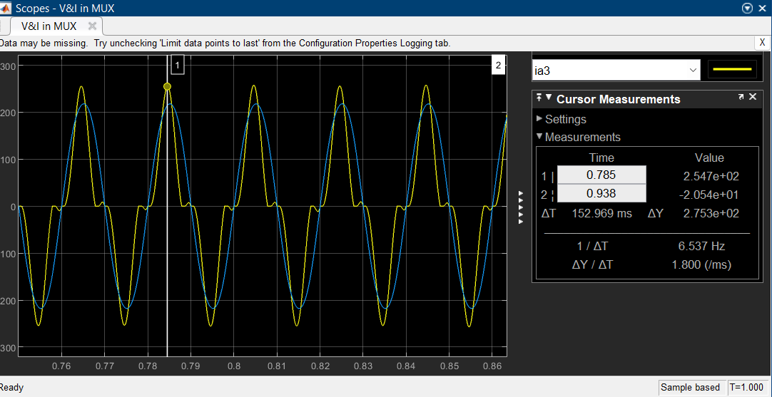
MATLAB (Input Voltage and Current Relationship )
Current Voltage

Slide 12
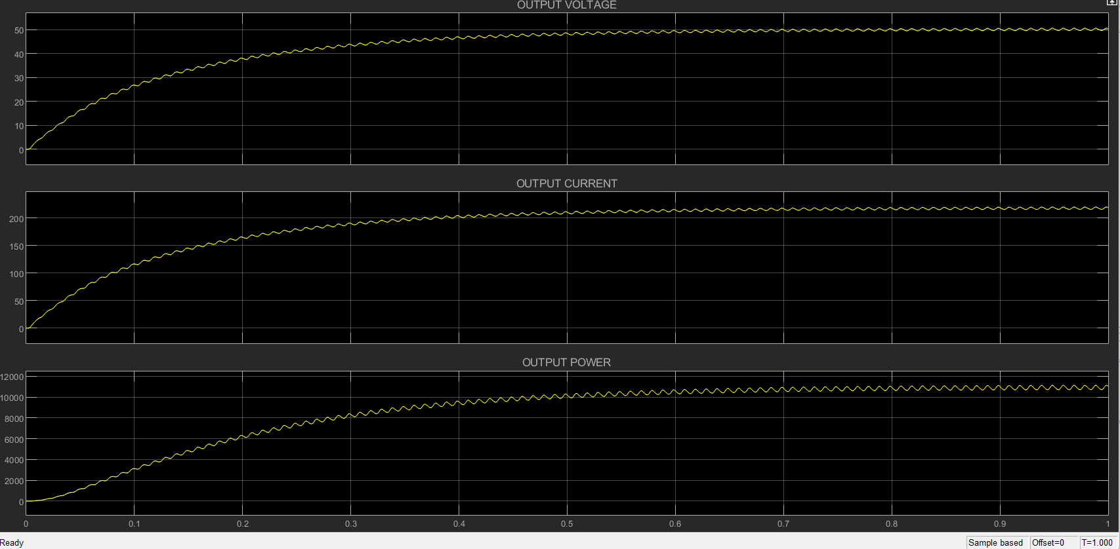
MATLAB (Output voltage ,current ,power)

Slide 13
MATLAB (Coupling-coefficient Relation)
K(Coupling Coefficient) | Mutual Impedance | Voltage(V) | Current(I) | Power(W)
0 | 0 | 0 | 0 | 0
0.25 | 71 | 0.1 | 0.3 | 0.03
0.5 | 140 | 0.2 | 1 | 0.2
0.75 | 215 | 0.5 | 2.5 | 2.5
0.85 | 240 | 1 | 4 | 4
0.9 | 255 | 2 | 6.5 | 13
0.95 | 270 | 4 | 16.3 | 62
0.98 | 278 | 13.5 | 58 | 1963
1 | 280 | 48 | 200 | 9600

Slide 14
For the hardware implementation we use different components. They are listed below as: 1. PIC Microcontroller 16F877A. 2. 7805 voltage regulator 3. MOSFET IRF 840 4. Step down transformer 230V/12 5. Step down transformer 230V/5 6. Capacitor 1000 μF,10 μF,47 μF 7. Resistor 0.46 MΩ, 0.7 K Ω 8. FAN739N IC 9. Diode 4007 10. Transistor IRF840
Hardware Requirement

Slide 15
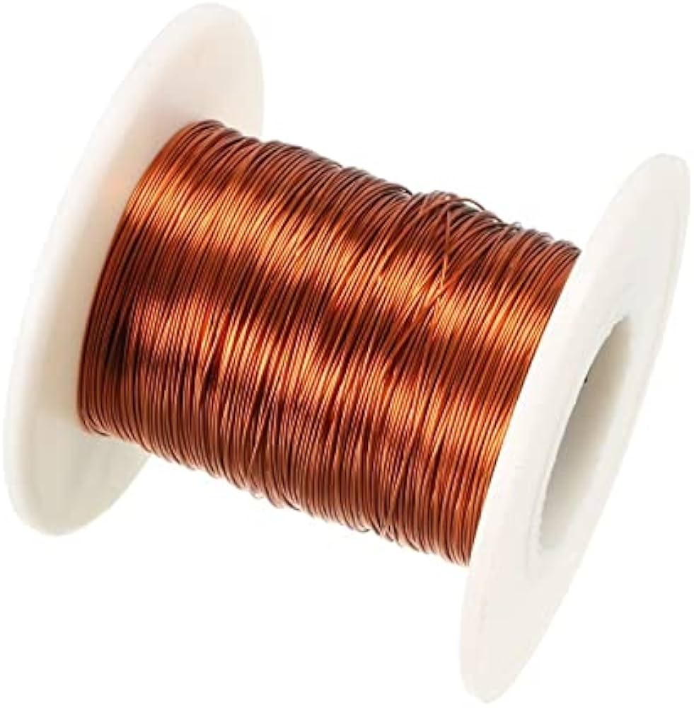
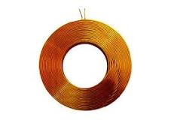
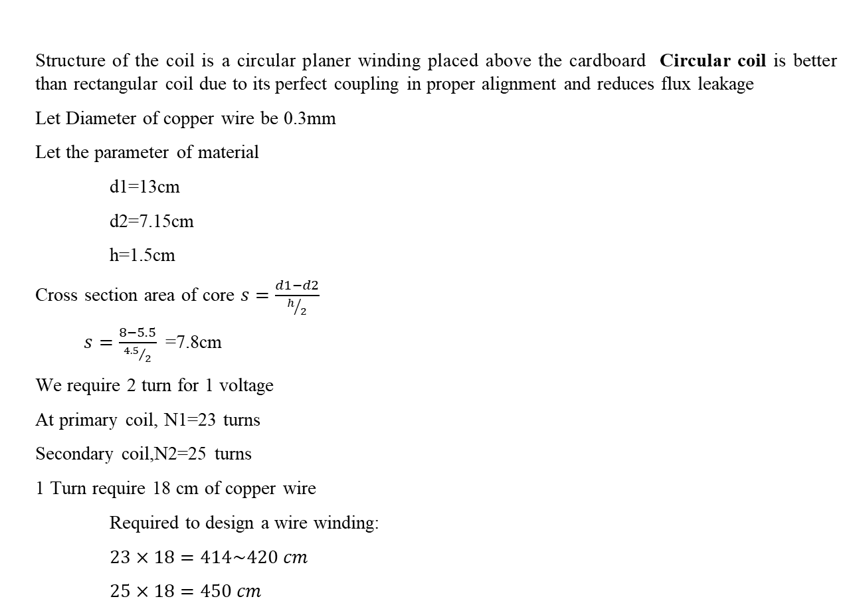
Coil Design
Structure of the coil is a circular planer winding placed above the cardboard Circular coil is better than rectangular coil due to its perfect coupling in proper alignment and reduces flux leakage
Let Diameter of copper wire be 0.3mm
Let the parameter of material
d1=13cm
d2=7.15cm
h=1.5cm
Cross section area of core $s=\frac{d1−d2}{h/2}$
$s=\frac{8−5.5}{{4.5}/2}$ =7.8cm
We require 2 turn for 1 voltage
At primary coil, N1=23 turns
Secondary coil,N2=25 turns
1 Turn require 18 cm of copper wire
Required to design a wire winding:
$23×18=414\sim 420 cm$
$25×18=450 cm$

Slide 16
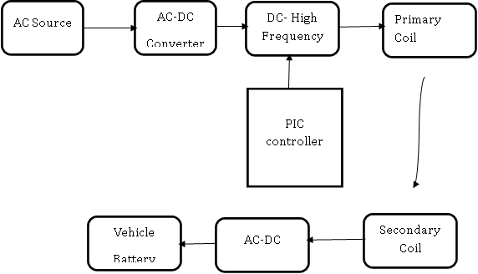
Block Diagram

Slide 17
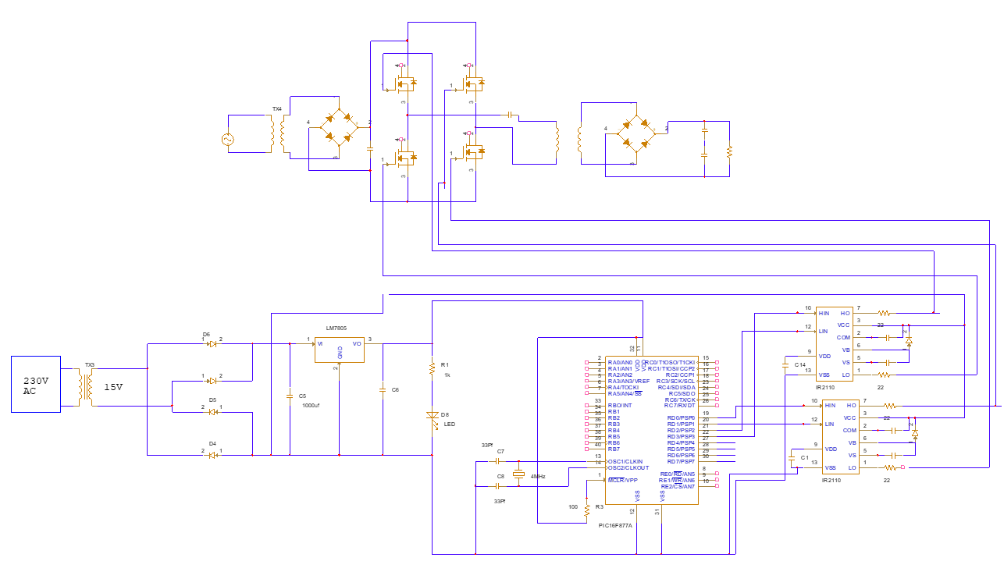
Connection Diagram

Slide 18
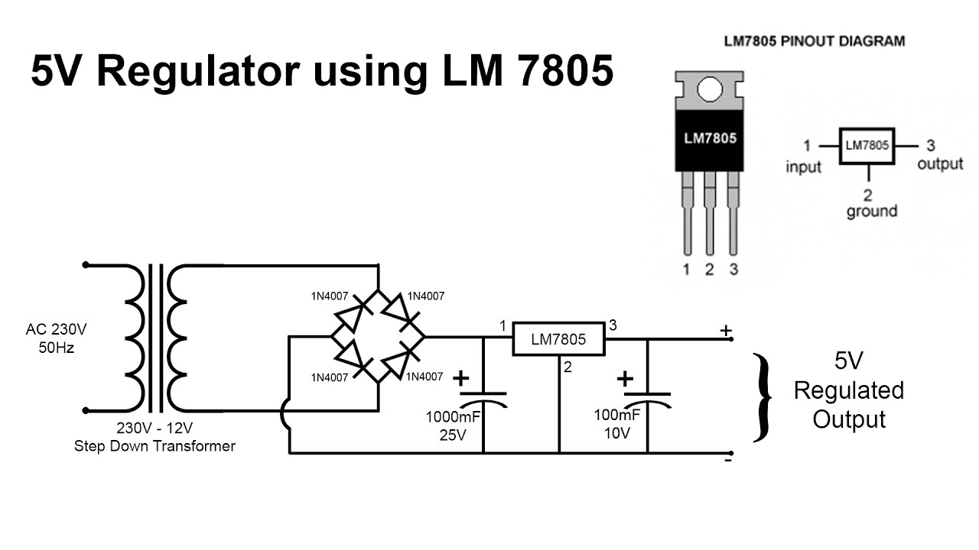
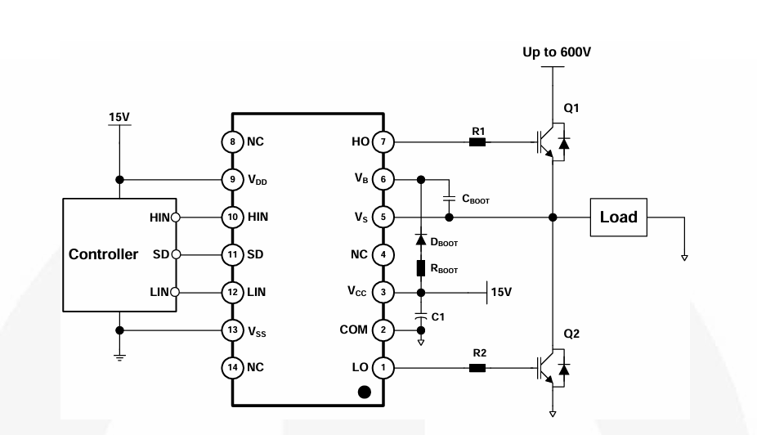
Voltage Regulator circuit
FAN7392 IC circuit

Slide 19
#include <pic16f877a.h> // Configuration settings #pragma config CP = OFF // Code protection off #pragma config WDTE = OFF // Watchdog Timer off #pragma config PWRTE = ON // Power-up Timer Enable bit (Power-up Timer is enabled) #pragma config LVP = OFF // Low Voltage Programming off #pragma config FOSC = XT // External oscillator mode selected #define COUNT1 0x21 void delay() { unsigned char i; for (i = 0; i < 255; i++) { // No operation, delay loop } } void main() { TRISD = 0x00; // Set all pins of PORTD as outputs while (1) { PORTD = 0x55; // Output 0x55 to PORTD delay(); // Delay PORTD = 0xAA; // Output 0xAA to PORTD delay(); // Delay } }
Code for PIC Microcontroller

Slide 20
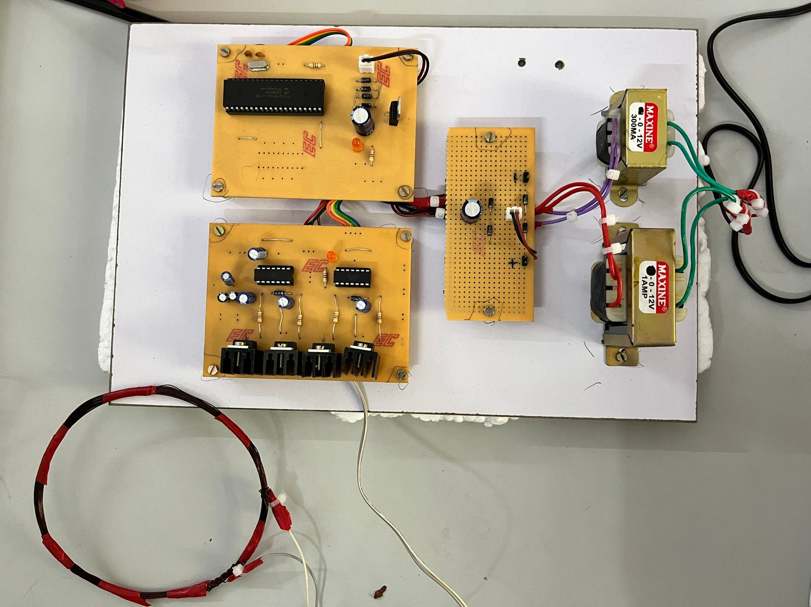
Primary circuit- Hardware
TRANSFORMER (5v):
Convert 220v to 15v
PIC CONTROLLER BOARD:
Set desire frequency for MOSFET
INVERTER:
Convert DC to AC supply
RECTIFIER:
Convert AC to DC source
TRANSFORMER (12v):
Convert 220v to 12v
PRIMARY COIL

Slide 21
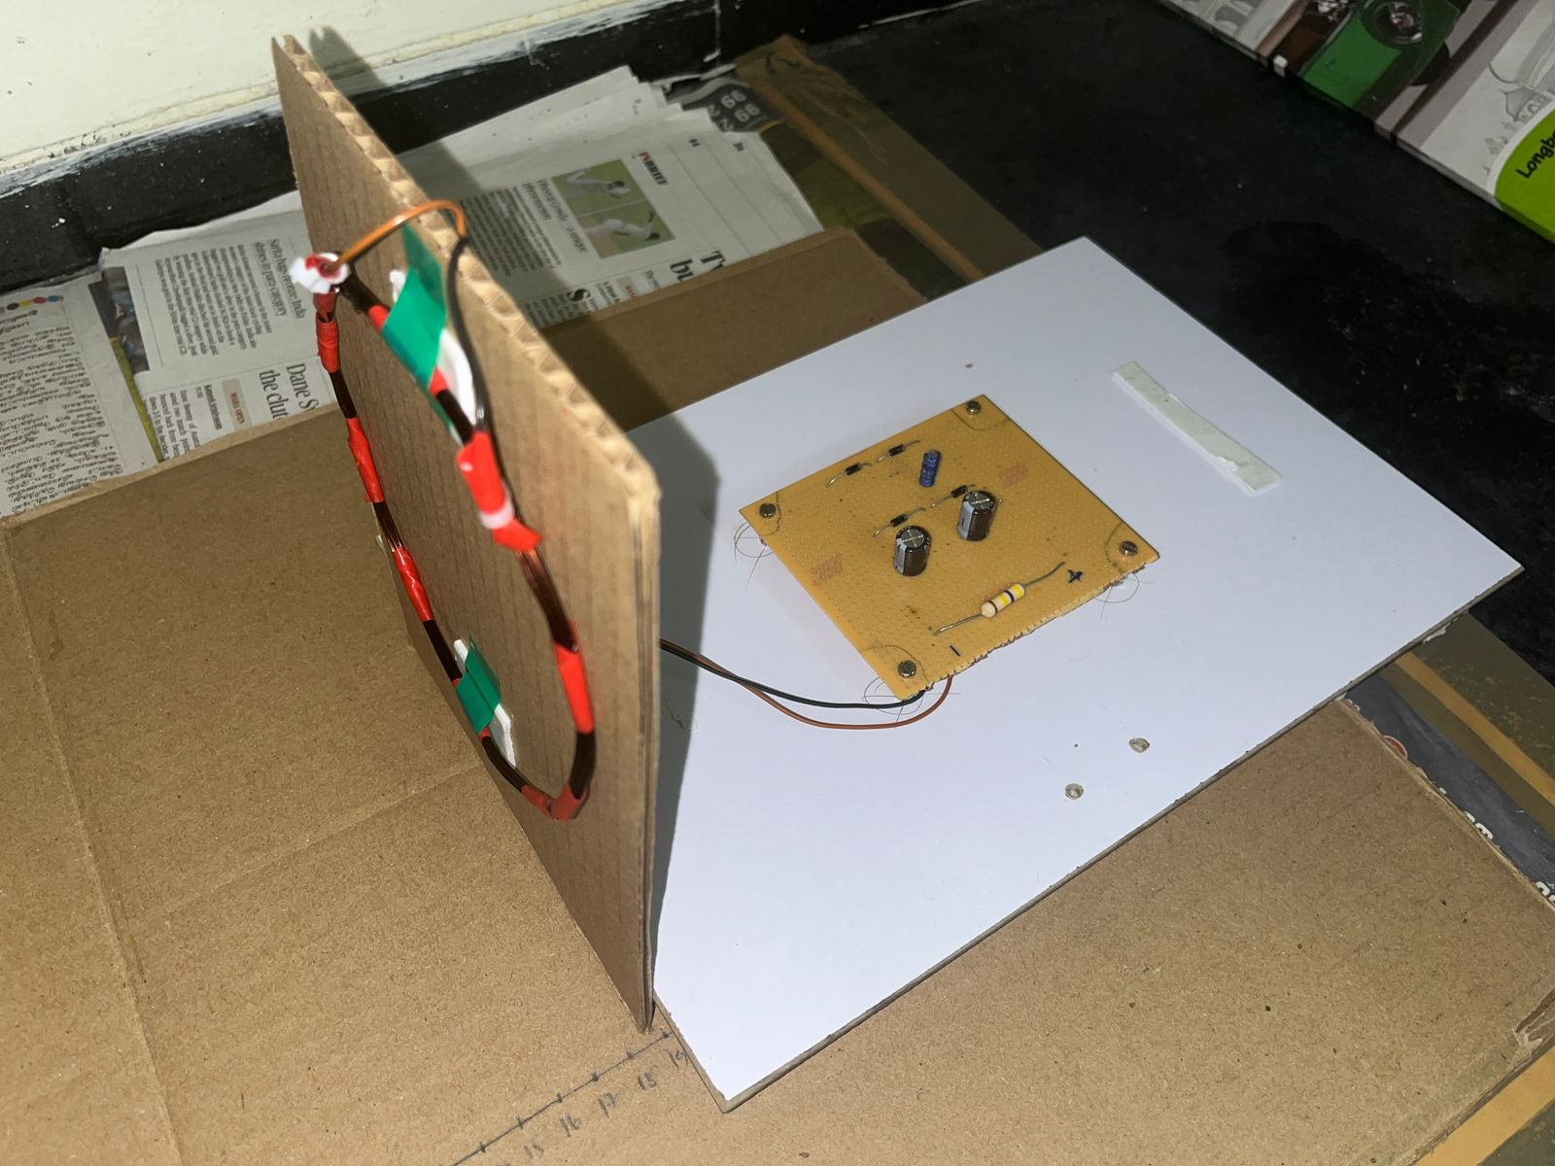
Secondary circuit- Hardware
SECONDARY COIL
RECTIFIER AND LOAD

Slide 22
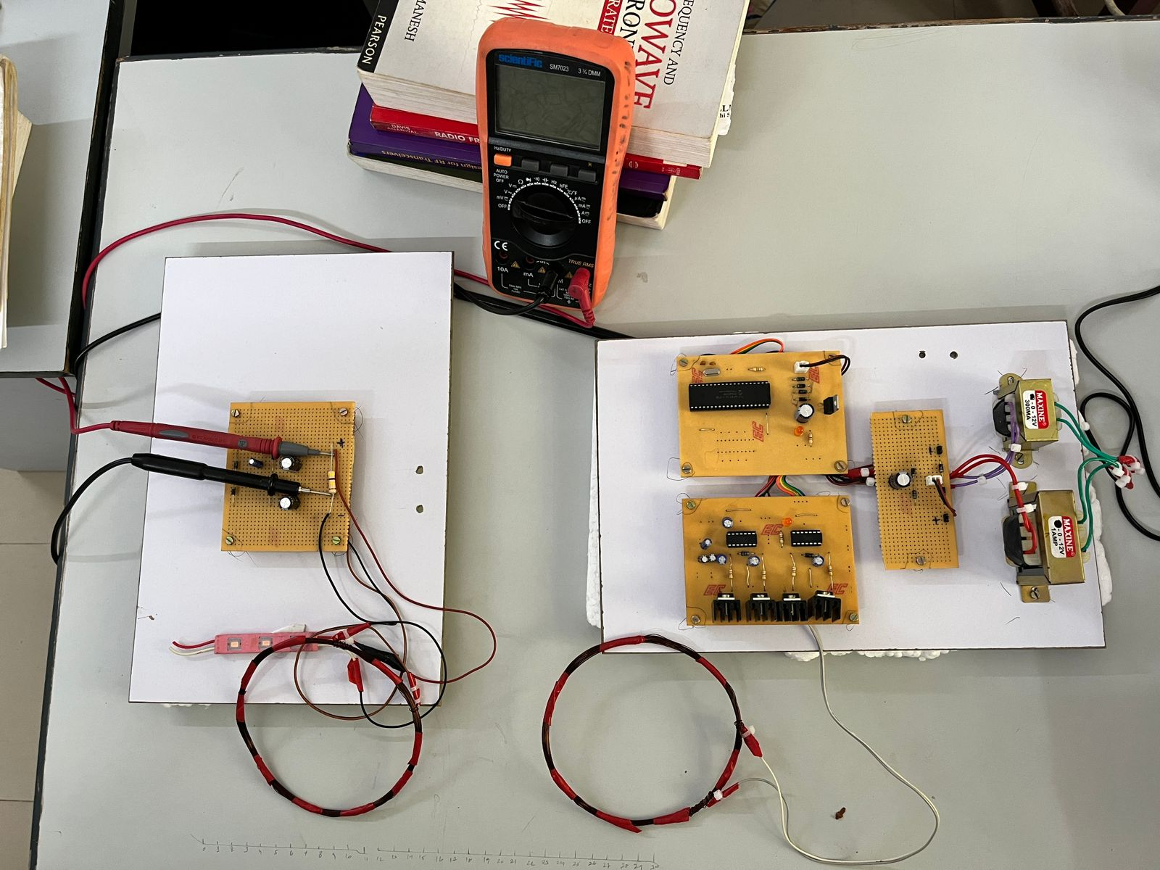
Overall Setup Hardware
RECEIVER
TRANSMITTER

Slide 23
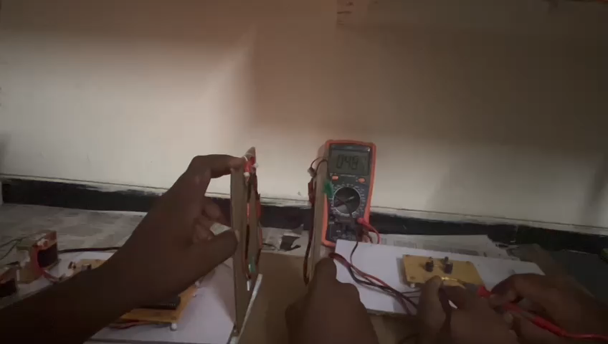
Demonstration Video

Slide 24
Distance Vs Voltage Relation
DISTANCE (cm) | VOLTAGE(V) | CURRENT (mA)@RL=0.48MΩ)
0 | 330 | 0.68
3 | 238 | 0.49
4 | 167.5 | 0.34
5 | 132 | 0.275
6 | 92.5 | 0.19
7 | 63.1 | 0.13
8 | 48.5 | 0.101
9 | 42.2 | 0.087
10 | 35.5 | 0.073
12 | 27.6 | 0.057
14 | 18.1 | 0.037
16 | 11.1 | 0.023
18 | 8.3 | 0.017
20 | 6 | 0.012
22 | 3.9 | 0.0081
24 | 3.1 | 0.0064
26 | 2.5 | 0.0052
28 | 1.9 | 0.0039
30 | 1.2 | 0.0025

Slide 25
Recharging a battery
Battery specification:
Lithium polymer battery also know as lipo or lipoly batteries which is used in GPS, DVD, Tablet PC, Bluetooth speakers.
The capacity of the Lipo battery is 3.7v 500mAh.
Charging Time:
Charging Time=Battery capacity/charging current
If Battery capacity is 500mAh,V=48v,R=0.48kΩ, I=0.1Ah
Then Battery charging time is
= 500mAh/0.1Ah
= 5hrs

Slide 26
LITERATURE STUDY
Sl. No | Title of the paper | Authors & year of publication | Journal/Conference Name | Techniques used | Inference
1. | Wireless Power Transfer for Electric Vehicle Applications | SiqiLi, Member, IEEE, and Chunting Chris Mi, Fellow, IEEE. 23 April 2014 | IEEE Journal of Emerging and Selected Topics in Power Electronics | Magnetic Coupler Design Compensation Network Power Electronics Converter and Power Control | Wireless charging will provide many benefits in particular, when the roads are electrified with wireless charging capability, it will provide the foundation for mass market penetration for EV regardless of battery technology.
2. | Power transfer for wireless charging in electric vehicles | AUGUST 28, 2020 BY DAVID ADEEB | 2020 EDN | AC/DC Converter with PFC LC compensation network | For stationary applications, plug-in charging has stolen a lead over wireless and is widely adopted and well understood. For dynamic charging, there are considerations around the nature of existing road designs, future maintenance, and whole life costs.

Slide 27
LITERATURE STUDY
Sl. No | Title of the paper | Authors & year of publication | Journal/Conference Name | Techniques used | Inference
3. | LC/CL compensation topology and efficiency-based optimization method for wireless power transfer | Yousu Yao, Xiaosheng Liu, Yijie Wan, 2018 | Institution of Engineering and Technology 25 April 2018 | LC/CL compensation topology Comparison with SS compensation topology | compensation topology, LC/CL This feature is desirable for WPT system due to its drastic simplification for control circuit design. The efficiency-based optimization methodology is presented to achieve highest system efficiency.
4. | Wireless Power Transfer in Electric Vehicles: A Review on Compensation Topologies, Coil Structures, and Safety Aspects | Benitto Albert Rayan, Umashankar Subramaniam, S.Balamurugan 28 March 2023 | Renewable Energy Lab, Department of Communications and Networks, College of Engineering, | Wireless Charging Technologies Conductive Type, Plug-In Charging, or Wired Charging | Different shapes of coil designs, and types of compensation topologies have been studied for varying power levels in EV applications

Slide 28
In our simulation of an inductive coupling circuit with a full-bridge rectifier, we studied how changing the coupling coefficient (K) affects energy transfer efficiency. Higher K values improved power transfer, but lower values posed challenges. Using a full bridge rectifier showed nuances in rectification, impacting voltage ripple and efficiency. This exploration offers insights for designing wireless power transfer systems, emphasizing the importance of ongoing research for improved efficiency in this evolving field.
CONCLUSION

Slide 29
A. K. RamRakhyani, S. Mirabbasi, and C. Mu, "Design and Optimization of Resonance-Based Efficient Wireless Power Delivery Systems for Biomedical Implants," Biomedical Circuits and Systems, IEEE Transactions on, vol. 5. L. Xie, Y. Shi, Y. T. Hou, and H. D. Sherali, "Making sensor networks immortal: An energy-renewal approach with wireless power transfer," IEEE/ACM Transactions on Networking (TON), vol.20, pp. 1748-1761, 2012. B. H. Choi, E. S. Lee, Y. H. Sohn, G. C. Jang, and C. T. Rim, "Six Degrees of Freedom Mobile Inductive Power Transfer by Crossed Dipole Tx and Rx Coils," IEEE Transactions on Power Electronics, vol. 31, pp. 3252 Mi, C.C.; Buja, G.; Choi, S.Y.; Rim, C.T. Modern Advances in Wireless Power Transfer System forRoadwayPoweredElectricVehiclesIEEETransInd.Electron.2016,63,6533–6545. Ghosh, A. Possibilities and Challenges for the Inclusion of the Electric Vehicle (EV) to Reduce the Carbon Footprint in the Transport Sector: A Review. Energies 2020, 13, 2602. González Palencia, J.C.; Nguyen, V.T.; Araki, M.; Shiga, S. The Role of Powertrain Electrification in Achieving Deep Decarbonization in Road Freight Transport. Energies 2020, 13, 2459. Xiaoli, S.; Zhengguo, L.; Xiaolin, W.; Chengjiang, L. Technology Development of Electric Vehicles: A Review. Energies 2020, 13, 90. DeSantis, M.; Agnelli, S.; Patanè, F.; Giannini, O.; Bella, G. Experimental Study for the Assessment of the Measurement Uncertainty Associated with Electric Powertrain E ciency Using the Back-to-Back Direct Method. Energies 2018, 11, 3536. S. A. Zaini, S. H. Yusoff, A. A. Abdullah, S. Khan, F. A. Rahman, and N. N. Nanda, “Investigation of magnetic properties for different coil sizes of dynamic wireless charging pads for electric vehicles (EV),” IIUM Eng. J., vol. 21, no. 1, pp. 23–32, 2020,doi:10.31436/iiumej.v21i1.1108.
REFERENCES

Slide 30
THANK YOU

